Slide 1
CISC108
Introduction to Computer Science
[Professor Name]
University of Delaware
Week 10 - Web Requests

Slide 2
Reminders
Midterm 2 this week!
Fill out Exam Trouble immediately after there is trouble. Do not wait to talk to your instructor!!!
Project 2 is also this week.
Do not wait to start Project 2!
Do not work with others on the Project
Complete each step before moving on to the next
Final Project begins next week!

Slide 3
The Web is a Function:
Request (URL)
↓
Response (Page/Data)

Slide 4
Requests Library
“HTTP for Humans”
Famously easy-to-use API for accessing web data in Python.
We installed it at the start of the semester!
# One-time import of requests library
import requests
# Get data from a URL
response = requests.get("https://...")
# Print out the content of the response
print(response.text)
https://requests.readthedocs.io/
Notes:
This would be a good time to pop over to Thonny and demo some code, I think.

Slide 5
Format of Data Returned
.text
.json()
Simple, raw string of data that we can process like any other data.
Structured data that needs to be refined before use. You won’t work with this directly yet!

Slide 6
Full Data Conversion
Request URL
Get back raw data
Format as “JSON”
Convert “JSON” to lists, dataclasses, and other Python types.
Encapsulated into a nice module - we do all the work for you with that module!

Slide 7
Today’s Libraries
Bakery Weather
Work with live weather data from USGS weather service!
Bakery Reddit
Access posts for a popular social-media/ link-sharing site.

Slide 8




Additional Difficulties
Slow Speed
No Wifi
Website changes
Non-deterministic
Limited by data transfer rates
Sometimes internet goes down
Request endpoint is not under your control
Data updates rapidly, hard to test consistently
Notes:
This introduces another feature of the libraries: their ability to handle certain kinds of internet difficulties. The next slide goes into details on the actual idea of caching

Slide 9
Solution: “Caching”
Cache
Requests-cache
Remember previously returned results for later reuse!
Popular library that seamlessly sits on top of Requests to “cache” requests.

Slide 10
Caching raises further problems…
Out-of-date cache
Caching bad data
Solution?
What happens when the data gets very old?
What if you accidentally cache the wrong data?
Delete the cache file (bakery_cache.sqlite) and try again!

Slide 11

Lecture 10 - Web Requests
Today you will be accessing web data to answer questions in a Google Doc.
Work in groups of three (or two).
Parts 1-3 are required.
Part 4 is extra credit if you reach it.
Part 5 (the reflection) is expected either way!
Notes:
You might want to review the next slide instead of launching in immediately, although I think it’s optional whether you show them those functions - if they’re getting it, they’re helpful tools. But if they’re struggling, better to stick with constants.

Slide 12
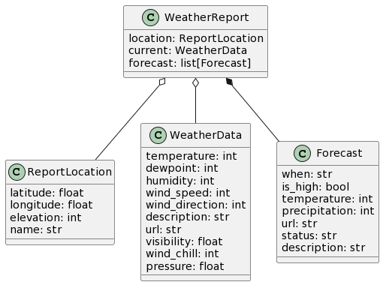
WeatherReport Structure

Slide 13
CISC108
Have a great day!
Don’t forget:
See ya!

